Slide 1

FinApp Budget Summit 2020

Slide 2
GOLD Programs
Leadership & Beyond
Emerging Leaders Program
Campus Programs

Slide 3
Our Signature Programs
L&B
Pre-orientation program that serves 30-40 incoming first years
Transition to Georgetown
$7,000
ELP
Fall semester programming for first years
Adjusting to Georgetown
Building community
$6,000

Slide 4
Campus Wide Programming
Leadership consulting, working with other organizations on campus that want to improve their leadership and mentorship skills.
Leadership 101: a 5 program long series that features different approaches to leadership
Extending GOLD’s use of leadership theory beyond first years

Slide 5
Why We’re Applying Again
ELP restructure
Our budget, allocated by the CSE, has not changed since FY17
Change in advisor and transitioning staff in the CSE

Slide 6
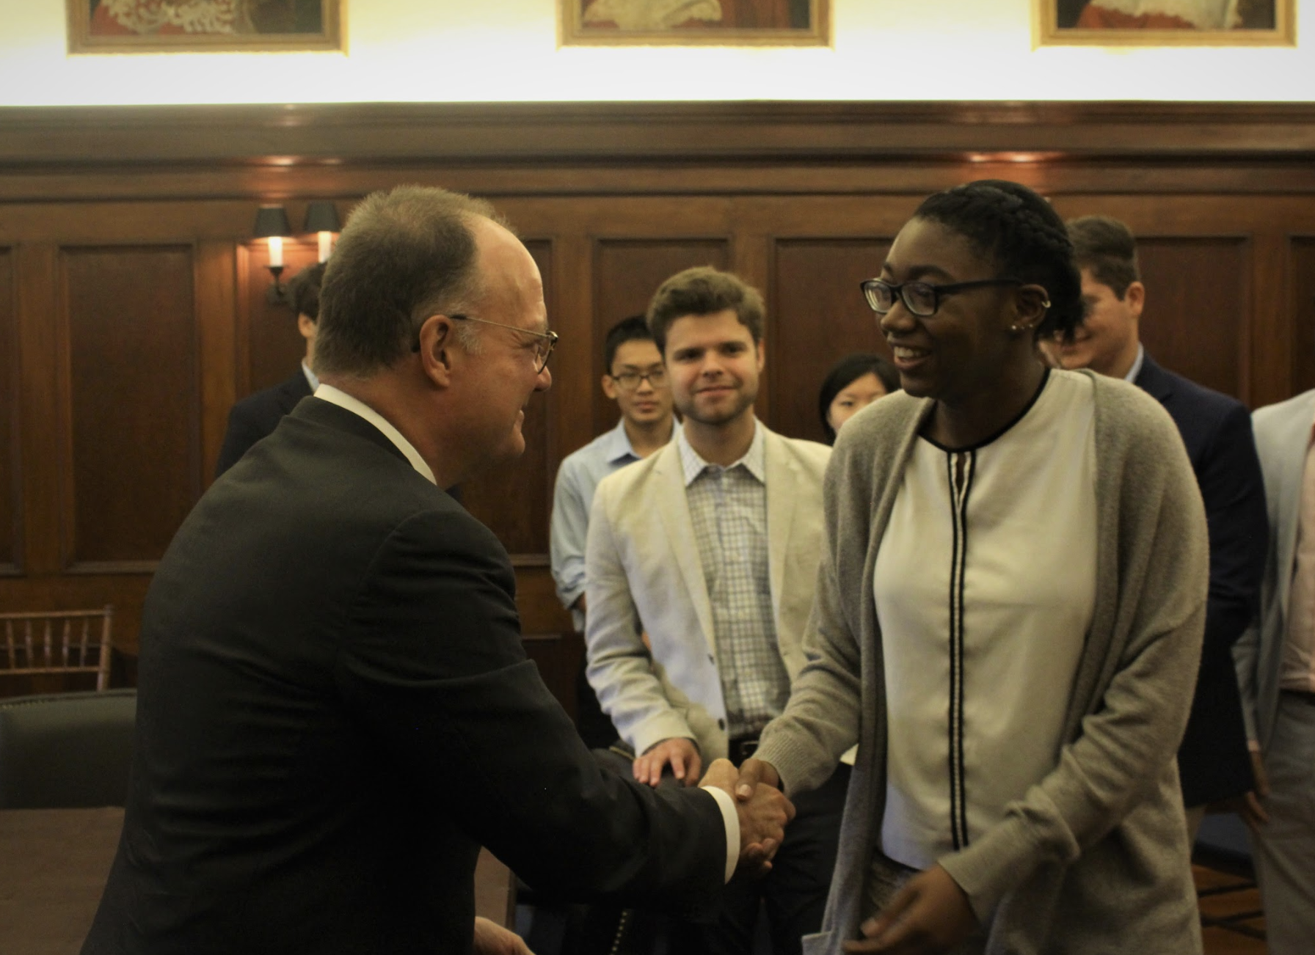
ELP Restructure
ELP: Women in 2020
Mentor Team Reduction
Issues with Participant Retention
Providing equal benefits to all participants of GOLD signature programs

Slide 7
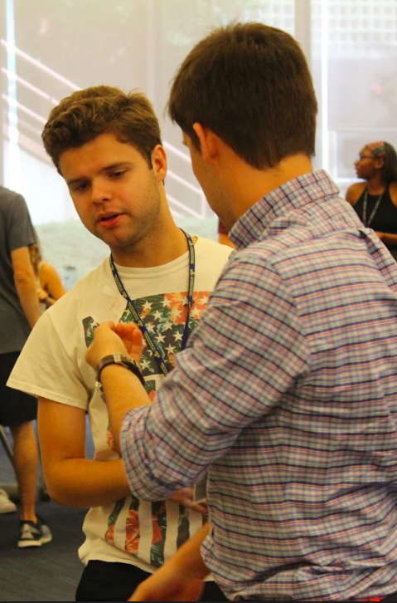
Program updates since FY17
Added campus wide programming
Leadership Speakers for L&B
Expansion of the program

Slide 8
Changes in the CSE
CSE supports us with Administrative Funds that we cannot reallocate
The staffing changes in the CSE affect the support of our program
Coordinator pay
We have historically been over-budget for salaries
With one less staff member in the CSE, more responsibilities are given to the coordinators which will only increase our hours worked

Slide 9
Questions?
Thank you for your attention!

